Slide 1
AMBIKA SILK HOUSE
PREMIUM SILK SAREE
PRESENTATION BY:
RISHIPRIYA T
III BCA
212402303
SSKV COLLAGE OF ARTS AND SCIENCE FOR WOMAN
EMAIL: rishipriya668@gmail.com

Slide 2


Slide 3
CATALOUGE USING IN AI
Saree image
Go to the Website
Upload the Saree photo
Choose the AI Model
Select Background
Generate Download & HD Quality

Slide 4
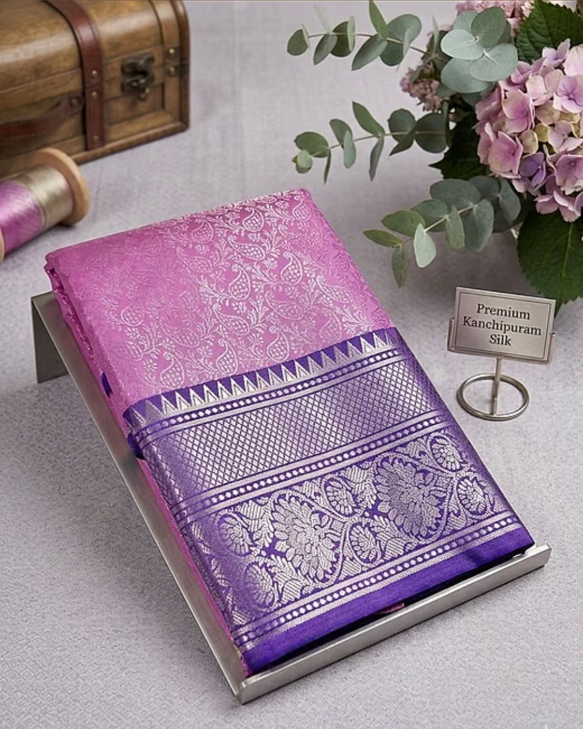
SAREE IMAGE
Spread your saree neatly on a flat surface like a mat, bed, or Table.
Take a clear photo using your smartphone, making sure the body, border, and pallu are fully visible.

Slide 5
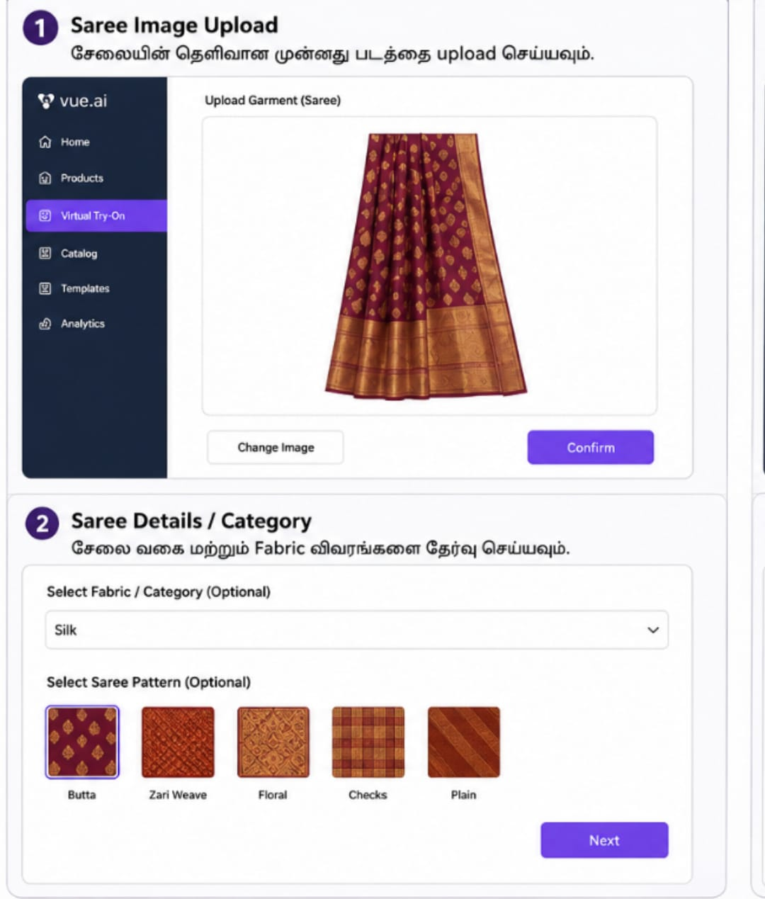
GO TO HE WEBSITE
Open the browser on your mobile phone or computer
Go to an AI fashion platform like ZMO.ai, Vue.ai, or Drape It and create a free account (Sign-up)
Select the feature named "AI Fashion Model" or "Virtual Try-On / Drape".

Slide 6

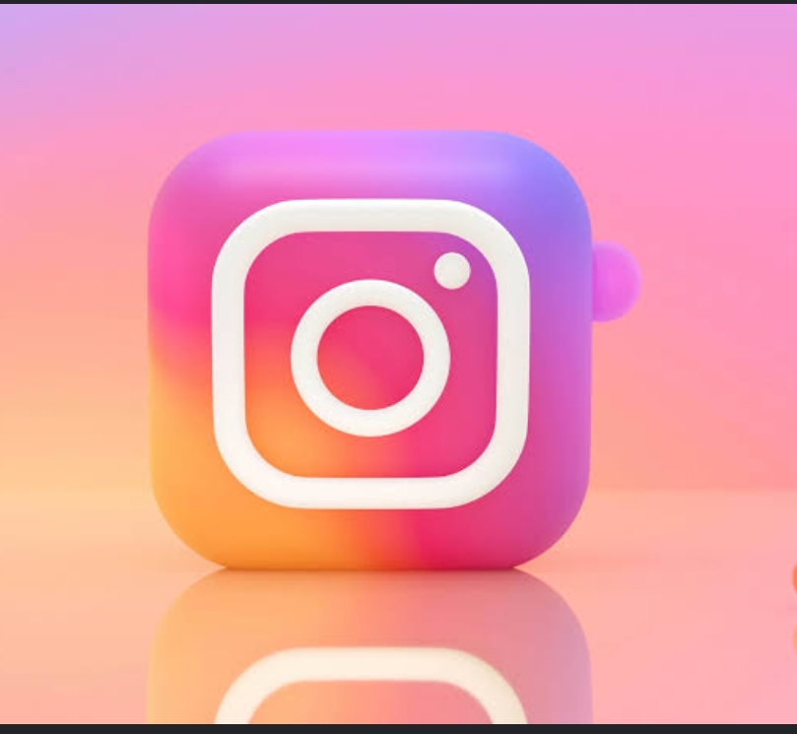
UPLODE THE SAREE PHOTO
Click on the 'Upload Clothes' or 'Garment Image' button inside the Tool.
Select and upload the saree photo you took in Saree image
If needed, crop the image so only the saree fabric and design are selected.

Slide 7
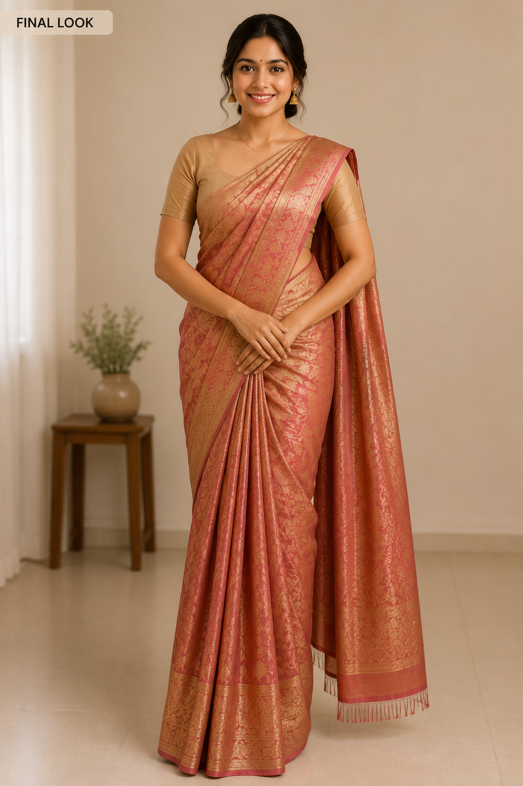
CHOOSE THE AI MODEL
The platform will display a list of pre-made digital AI models.
Choose a model with an Indian ethnicity/look to suit the saree traditional Vibe.
You can also select the model's pose, age, and hairstyle based on your choice.

Slide 8
BACKGROUND
Background: Pick a background that complements the saree, such as a
luxury palace interior for bridal silk sarees or a clean studio background for casual Sarees.

Slide 9
GENERATE AND DOWNLOAD
Within a few seconds, the AI will perfectly drape the saree onto the model with natural-looking Pleats.
If you like the final result, click the 'Download' button to save the image in high definition (HD) quality

Slide 10
AI USAGE
Premium Website:
Makes your Shopify or online store look highly professional.
Social Media Ads:
Model images work best for paid advertisements on Facebook and Instagram.

Slide 11
Wholesale PDFs:
Creates clean digital catalogues to share with bulk buyers.
Advance Bookings:
Helps collect customer orders before buying stock.
Daily Content:
Gives you unlimited photos for regular WhatsApp status updates.

Slide 12
BENIFIT OF AI
No Model Cost:
Saves thousands on real models and photographers.
Super Fast:
Creates catalogue photos in just a few minutes.
More Sales:
Attracts more buyers on WhatsApp and Instagram.
Zero Waste:
Checks the look before weaving or buying bulk.
Easy Edits:
Changes models and backgrounds with one click.

Slide 13
THANK YOU

