Slide 1
AI in gaming presented by Nithiyasri
S.S.K.V.COLLEGE OF ARTS AND SCIENCE FOR WOMEN
BCA-III YEAR
REGISTER NUMBER NO: 212402299
EMAIL ID: ramaisureshramaisuresh@gmail.com

Slide 2
Introduction:
Artificial intelligence is transforming gaming by creating intelligent NPCs, dynamic worlds, personalized gameplay, and procedural content, making games more immersive and adaptive.

Slide 3
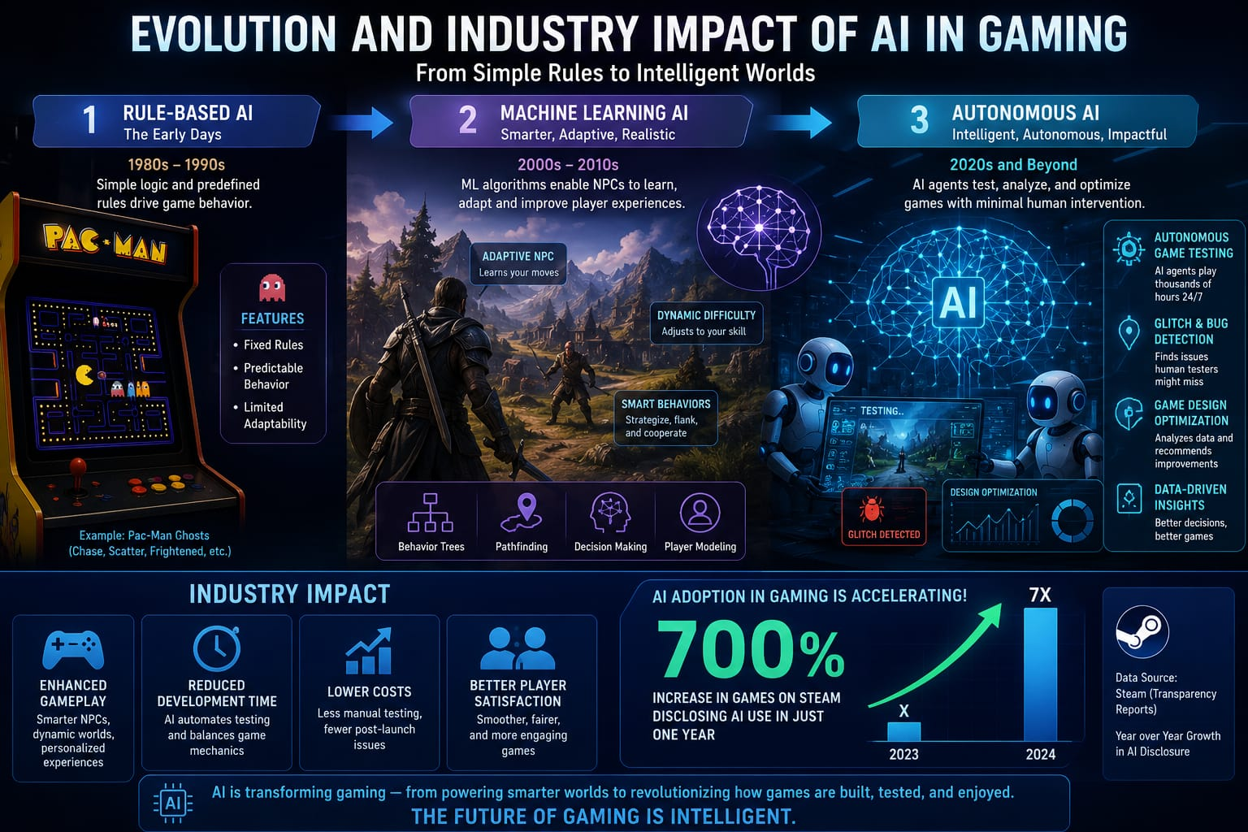

Slide 4
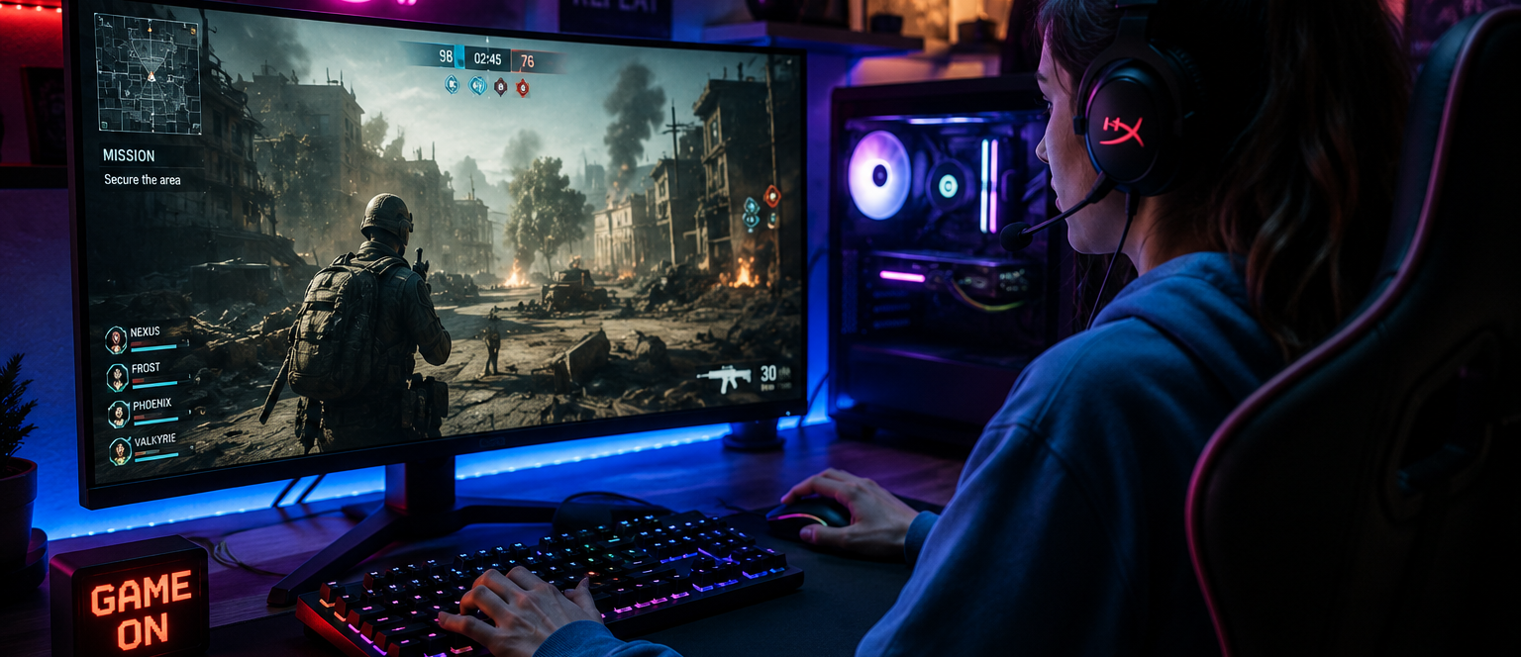
Artificial Intelligence:
There two types: symbolic Ai & machine learning

Slide 5
Symbolic AI: strategic opponents non-player characters managing experience
 | GAME AI
 | AI FOR THE PLAYER EXPERIENCE
NON-player character | Procedural generations -----→ | <--------
Strategic opponents | ----------------------------------------→ | ONLINE MATHMAKING
Managing experience | Real-time rendering
AI that plays | AI That creater | THAT MODELS

Slide 6
MACHINE LEARNING:
Machine Learning (ML) in gaming means using algorithms that learn from data and player behavior to improve or automate parts of a game, instead of relying only on fixed rules.
Examples of Machine Learning in Games:
Smarter NPCs: Enemies or teammates learn better strategies based on how players play.
Personalized gameplay: The game adjusts its difficulty based on your skill level.
Artificial Intelligence (AI) │ └── Machine Learning (ML) └── Deep Learning (DL) └── Generative AI (GenAI)
Player recommendations: Suggests games, characters, or items you might like.
Cheat detection: Identifies players who are likely cheating by recognizing unusual patterns.
Matchmaking: Pairs players with others of similar skill to create fair matches.

Slide 7
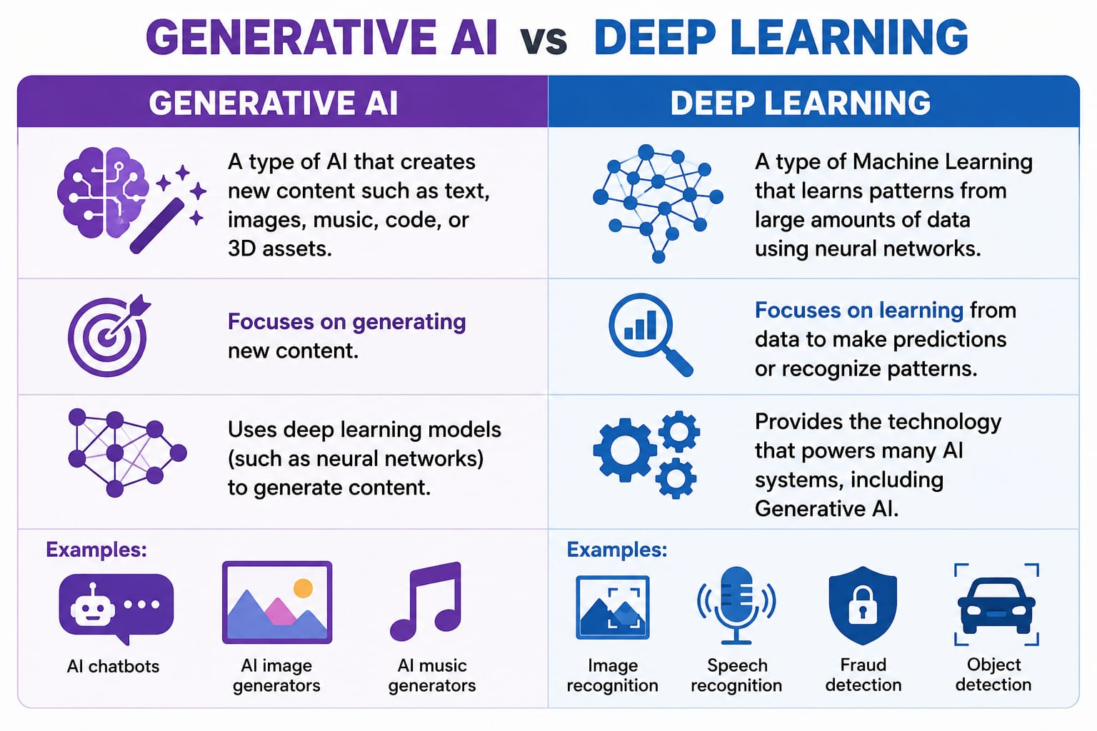
MACHINE LEARNING:
Deep learning and generative ai:

Slide 8
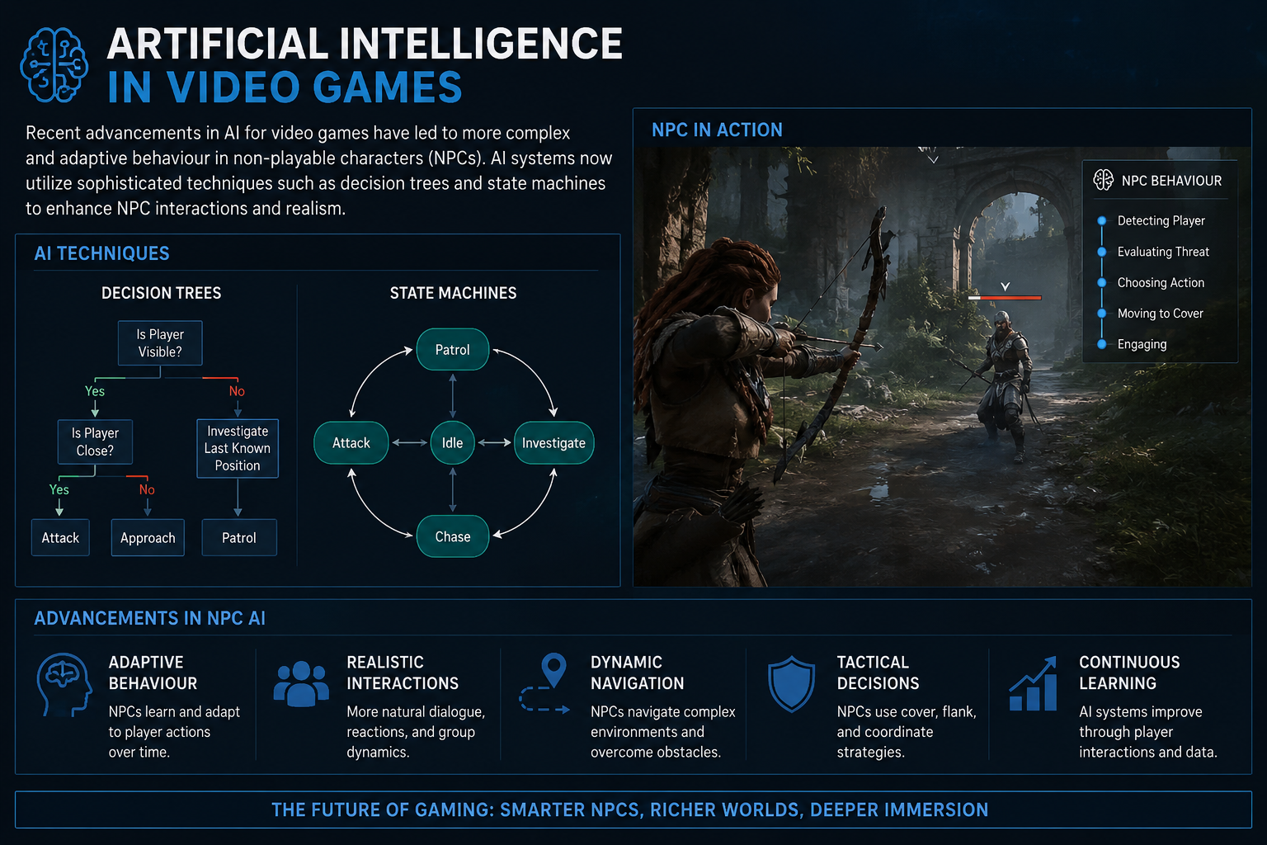

Slide 9
Evolution and Technology
AI in gaming has evolved from simple rule-based systems in early games like Pac-Man to sophisticated neural networks and machine learning models.
Modern AI supports real-time ray tracing, neural rendering, and adaptive storytelling, enhancing immersion and realism.

Slide 10
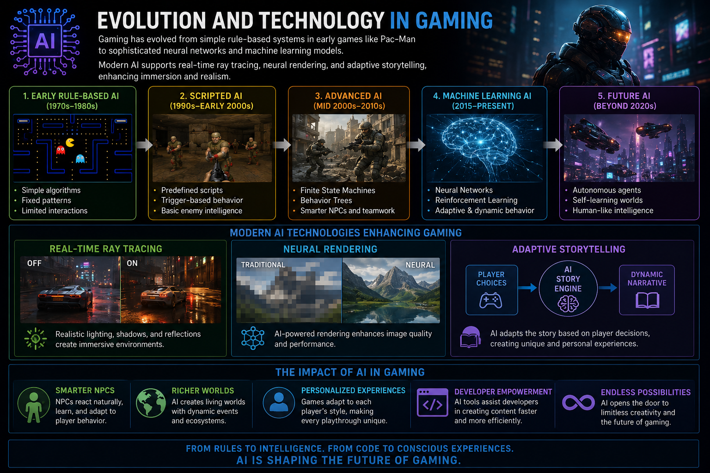

Slide 11
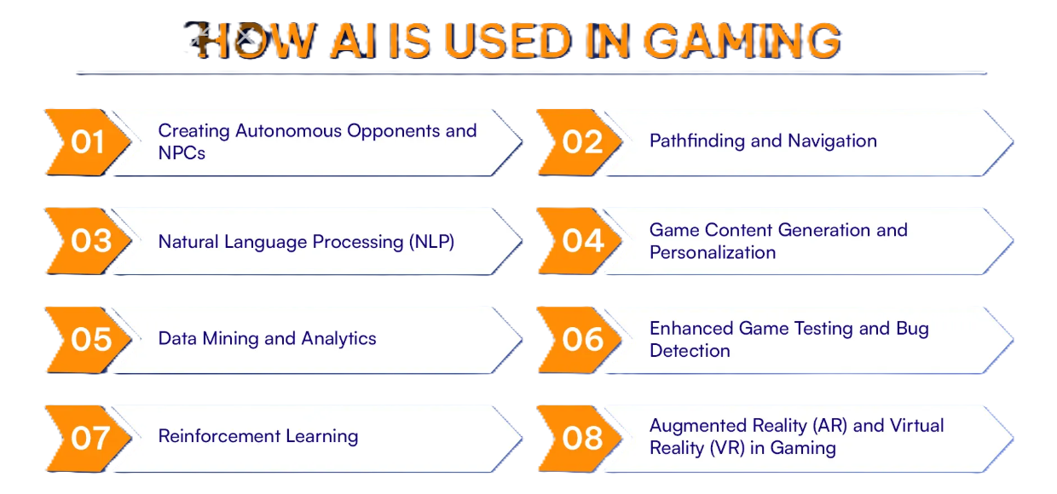

Slide 12
Key Applications:
Intelligent NPCs:
Dynamic Game Worlds
Personalized Gameplay
Game Balancing and Analytics
Generative Content

Slide 13
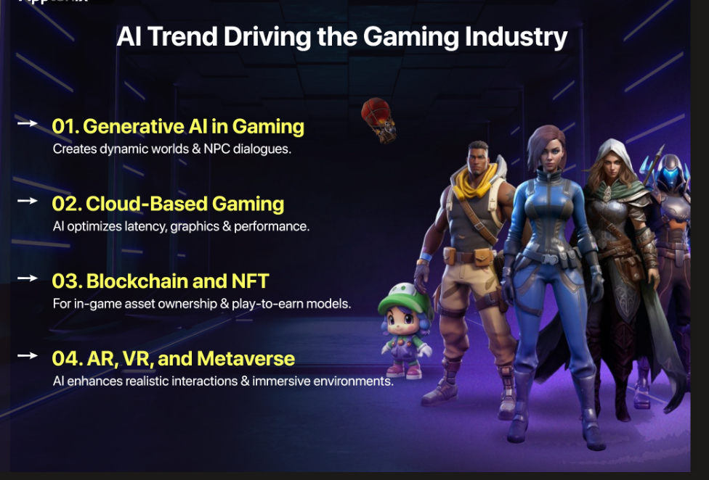

Slide 14
Thank you

