Slide 1
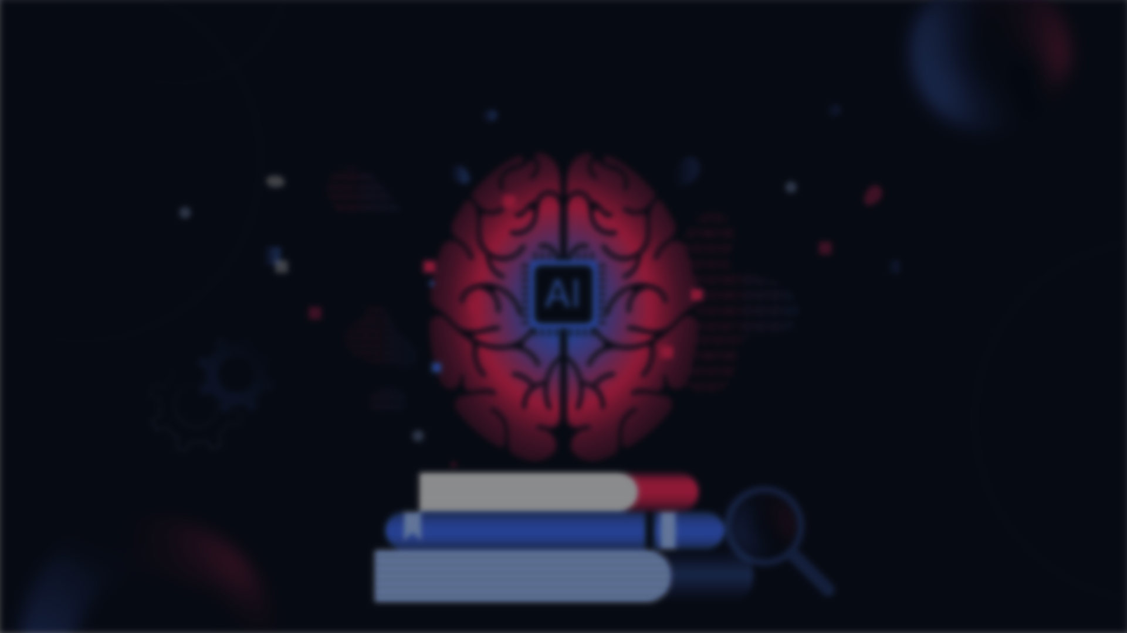
AI IN EDUCATION
NAME : S. TAMILARASI
REG NO : 212402312
YEAR: II BCA
COLLEGE: S.S.K.V COLLEGE OF ARTS AND SCIENCE
EMAIL: tamilsaravanan798@gmail.com

Slide 2
INTRODUCTION
Education has changed from classroom-based teaching to technology-supported learning. Books, computers, the internet, and Artificial Intelligence have made learning more accessible, interactive, and personalized, helping students learn more effectively in the modern world.

Slide 3
TYPES OF EDUCATION
Traditional Learning
Normal Learning
Internet Learning
AI Learning

Slide 4
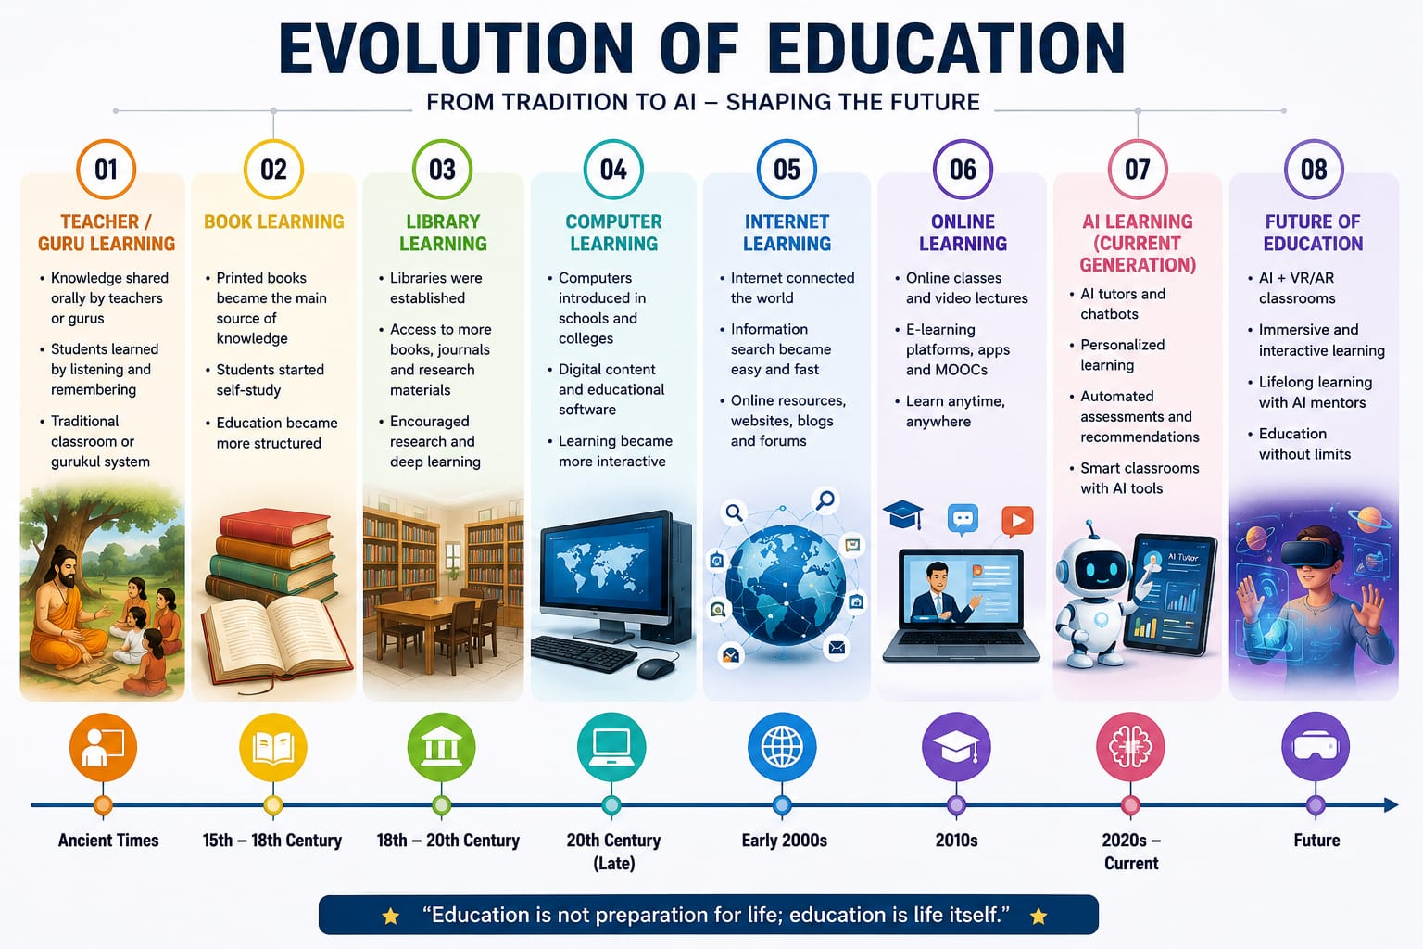

Slide 5
Evolution of Education
Traditional Learning
Teacher/Guru Learning
Book Learning
Library Learning
Normal Learning
Computer Learning
AI Learning
AI Learning (Current Generation)
Future AI Education
Internet Learning
Internet Learning
Online Learning

Slide 6
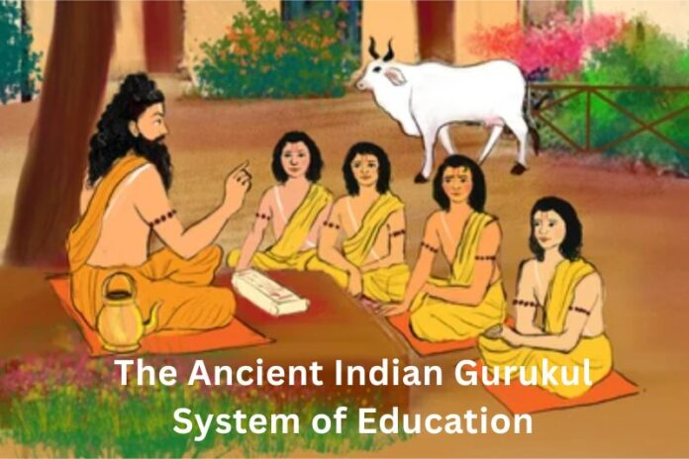
Traditional Learning
Teacher/Guru Learning
The Gurukul system dates back to 5000 BCE, during the Vedic period. Derived from the Sanskrit words “Guru” (teacher) and “Kula” (family/home), it was a residential schooling system where students lived with their Guru in an ashram-like environment.
In ancient times, there were no computers, internet, or printed books. Students learned by listening to their teachers, asking questions, and memorizing lessons. The teacher was the main source of knowledge and guided students in education, discipline, and life skills. This system was commonly known as the Gurukul System.

Slide 7
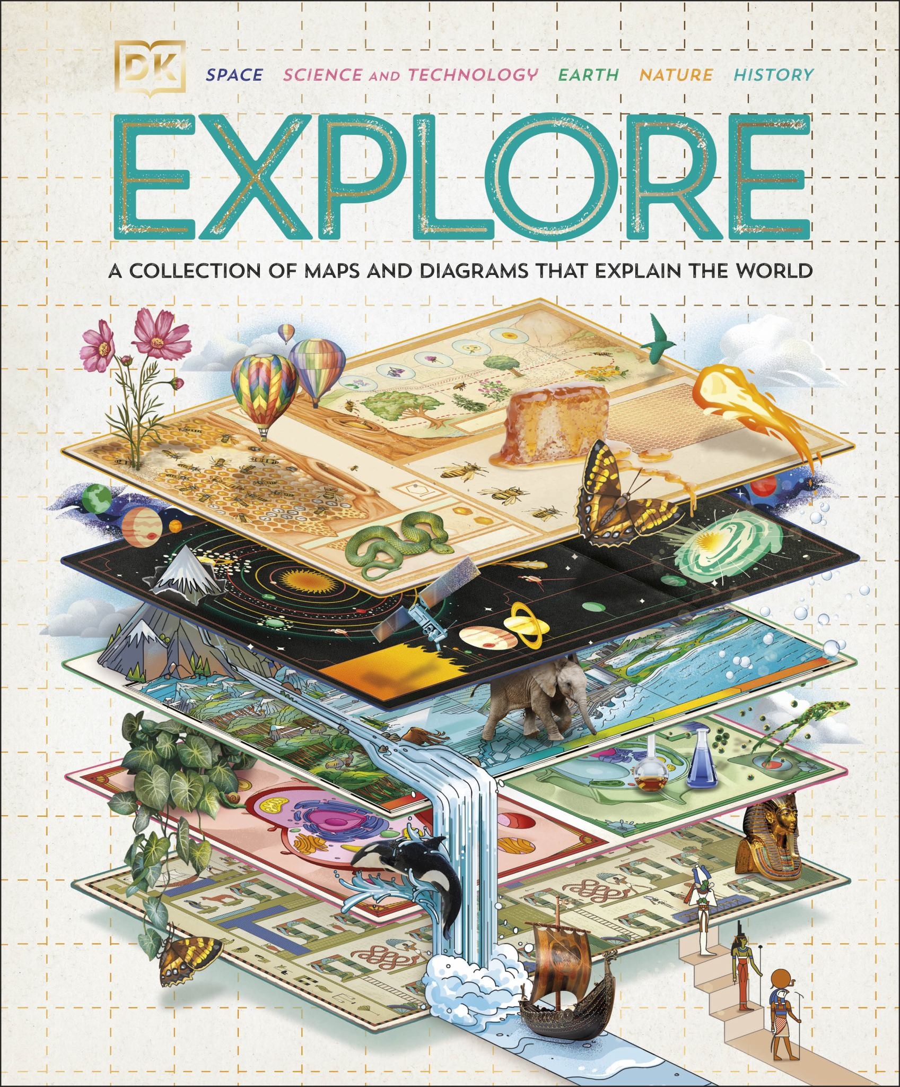
Traditional Learning
Book Learning
After the invention of printing, books became the main source of education. Students could read, write, and learn independently using textbooks. Unlike the Guru Learning system, knowledge was stored in books and could be shared with many people. This made education more organized and accessible.

Slide 8
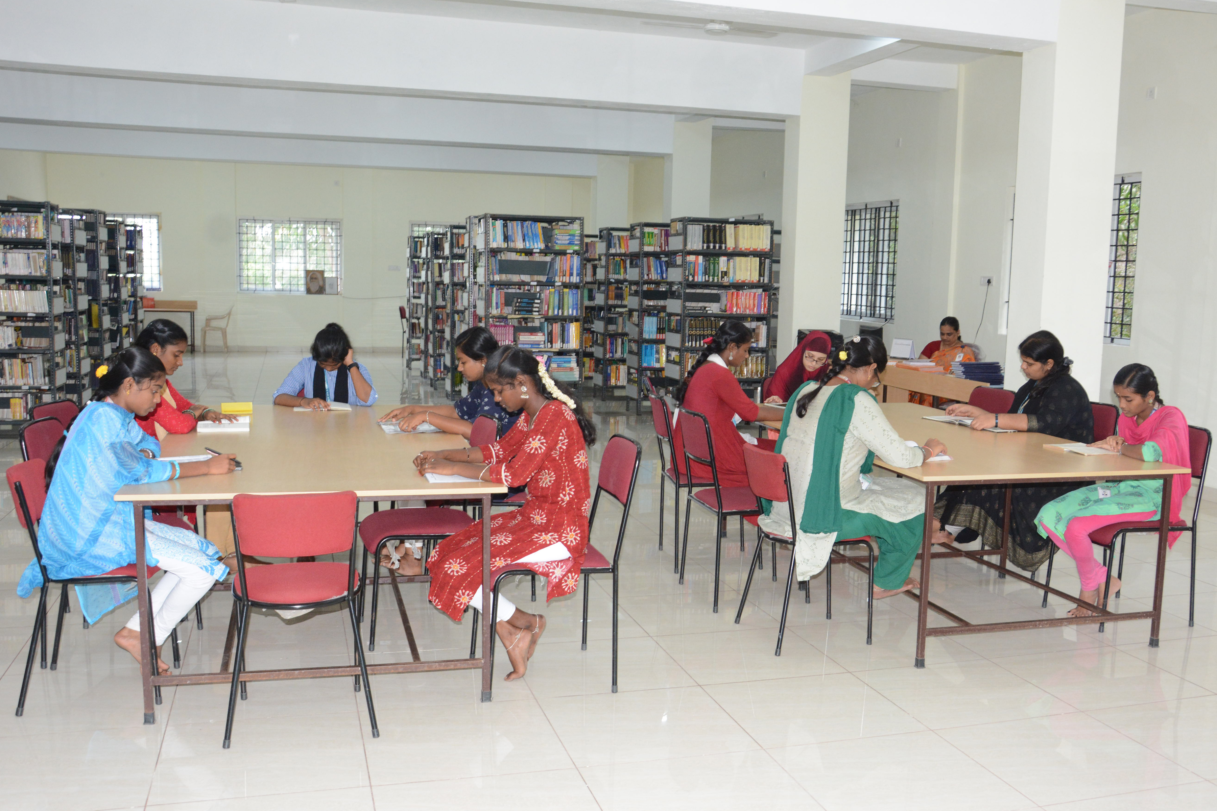
Traditional Learning
Library Learning
Libraries became important centers of education by providing access to books, journals, and research materials. It encouraged self-learning, research, and deeper understanding of subjects.

Slide 9
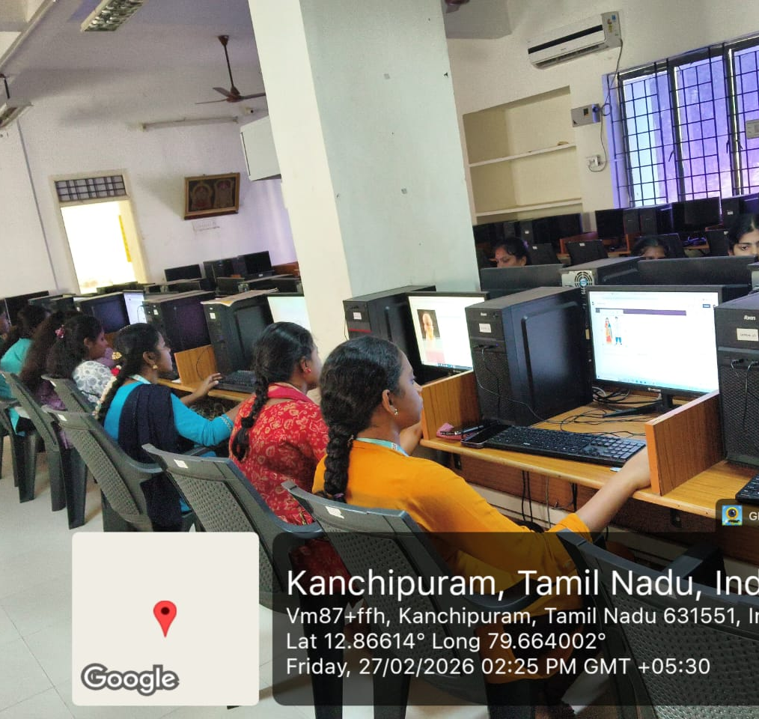
Normal Learning
Computer Learning
Learning with the help of computers and digital technology.
Uses educational software, CDs/DVDs, multimedia presentations, and educational games.
Main focus: Interactive and digital learning.
Example:
Using a computer to learn Mathematics through educational software, practicing typing, or studying from a CD/DVD course.

Slide 10
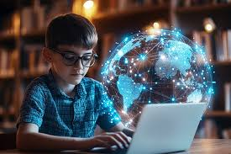
INTERNET & ONLINE LEARNING
INTERNET LEARNING
Learning by searching and accessing information through the internet.
Uses websites, Google, blogs, and online resources.
Main focus: Accessing information and knowledge quickly.
Example:
Searching for a topic on Google and learning from websites and online articles.
ONLINE LEARNING
Learning by attending classes through the internet.
Uses video lectures, virtual classrooms, and online learning platforms.
Main focus: Teaching and Learning remotely.
Example:
Attending classes through YouTube, Zoom, Google Meet, or online courses.

Slide 11
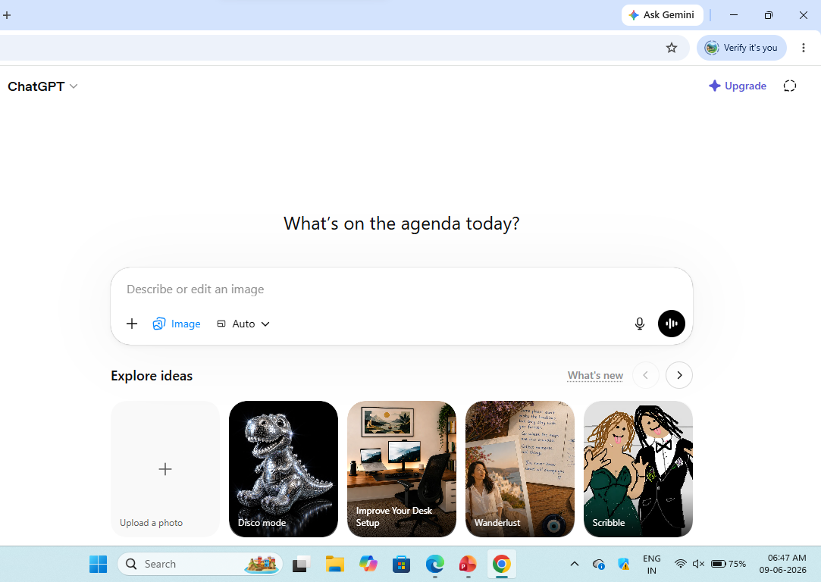
AI Learning
AI Learning (Artificial Intelligence Learning)
Learning with the help of Artificial Intelligence (AI) technologies.
Uses AI tutors, chatbots, and intelligent learning systems.
Provides personalized learning based on each student's needs and performance.
Main focus: Personalized and Smart Learning.
Example:
Using ChatGPT, AI tutors, or AI-powered learning platforms to get instant answers, explanations, and study support

Slide 12
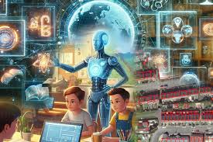
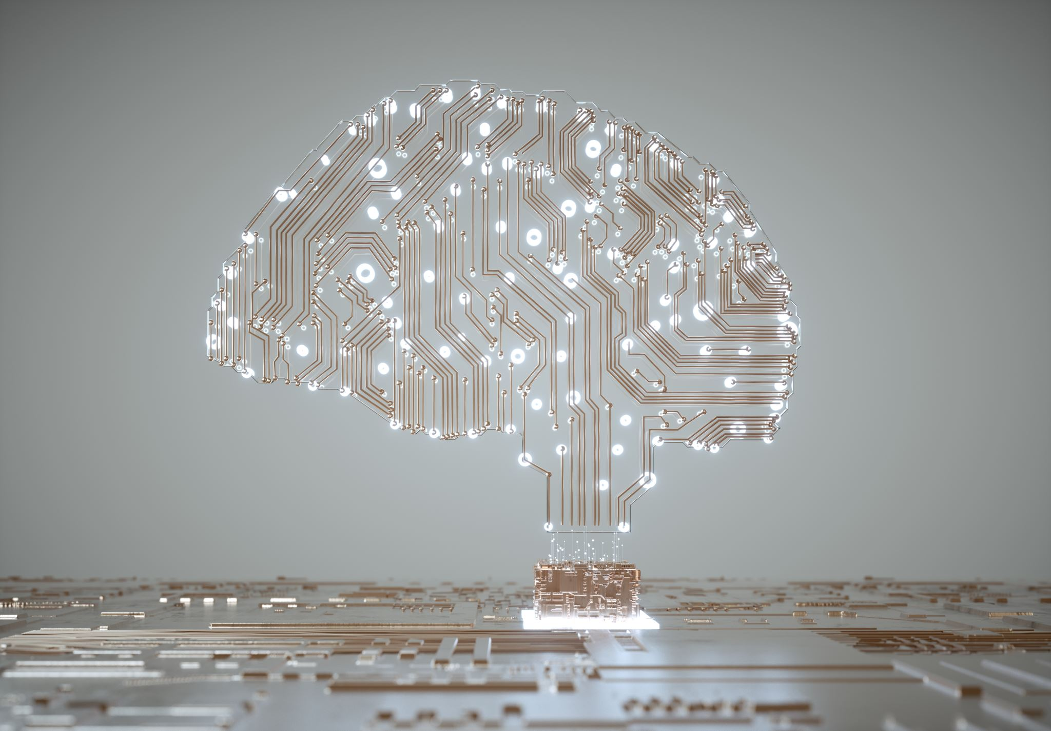
Future AI Education
Future AI Education is an advanced learning system where Artificial Intelligence provides personalized instruction, intelligent tutoring, real-time feedback, and immersive learning experiences to enhance student success.

Slide 13
Thank you

