Slide 1

Artificial Intelligence in E-Commerce
A case study on compressed Sambrani
NAME : S.KOMALA
COLLEGE : S.S.K.V COLLEGE OF ARTS AND SCIENCE FOR WOMEN
YEAR : II
REGISTER NUMBER : 212402292
EMAIL ID : komalasekar2007@gmail.com

Slide 2




INTRODUCTION
What is AI?
What is E-Commerce?
Why It Matters
Artificial Intelligence is the ability of computer systems to learn, reason and make decisions — much like a human would.
E-Commerce means buying and selling goods and services online, through websites and mobile apps.
Together, AI and e-commerce help traditional businesses reach far more customers and grow faster.

Slide 3
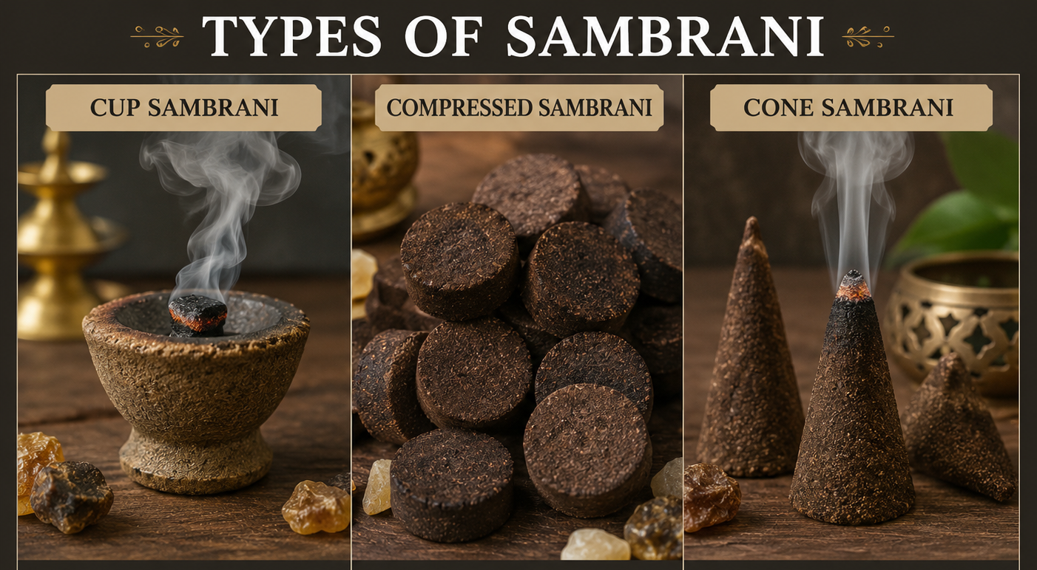
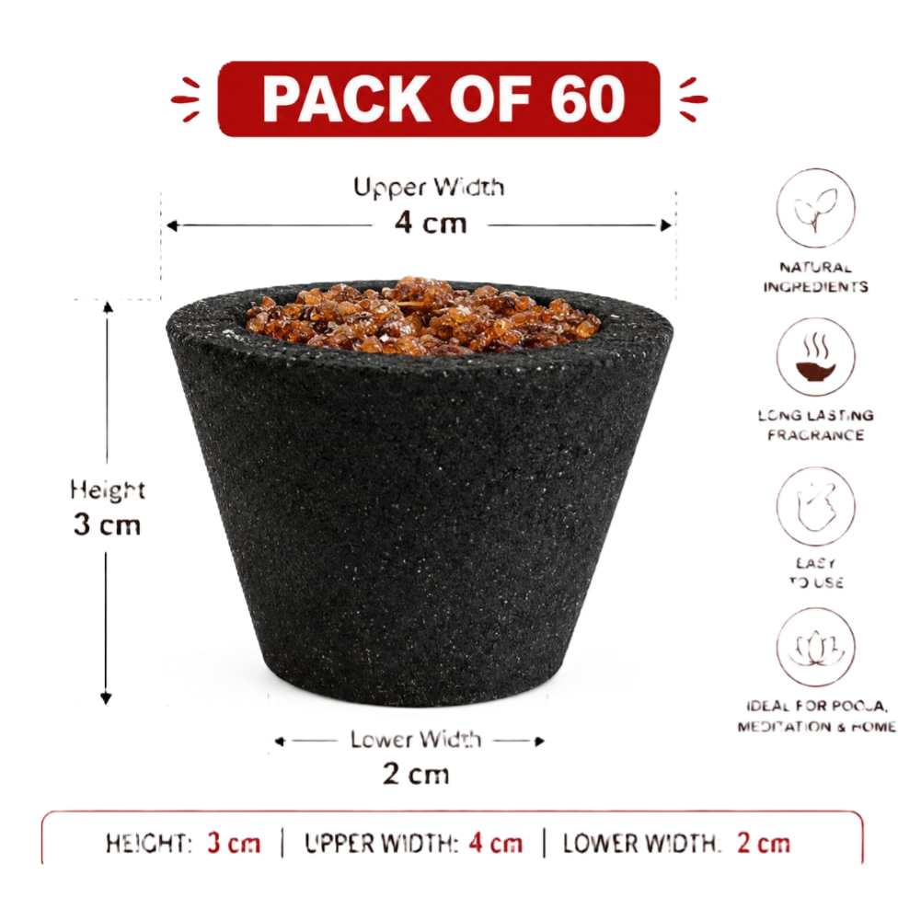
About Compressed Sambrani
Compressed Sambrani is a traditional aromatic product, made by pressing fragrant resins and herbs into easy-to-light cones and cups.
Now sold through e-commerce websites and apps, reaching customers far beyond local markets
Valued for its long-lasting fragrance, clean burn and convenient shape
Used daily for pooja, prayer at home and in temples
Compressed Sambrani
Cones , Compressed & Cups

Slide 4


How AI Powers E-Commerce
AI gives online businesses three core superpowers:
Understands Customer Behaviour
Analyses browsing and buying patterns to learn what each shopper wants, often before they search for it.
Automates Repetitive Tasks
Handles order sorting, customer replies and catalogue updates automatically, freeing up staff time.
Improves Business Decisions
Turns raw sales data into clear insights that guide pricing, stocking and marketing choices.

Slide 5





Product Recommendations
AI studies past purchases to suggest fragrances a customer is likely to love — turning one sale into many.
1
2
3
4
Purchase History
AI Engine
Suggested Fragrances
Increased Sales
Customer’s past orders are reviewed
Patterns and preferences are matched
Related sambrani scents are recommended
More repeat purchases and bigger orders

Slide 6




AI Chatbots
24/7 Customer Support
Shoppers get help at any hour, even when no staff are online.
Order Tracking
“Where is my order?” is answered instantly, without human staff.
Always-on conversations with every customer.
Instant Replies
Common questions on pricing, fragrance and shipping are answered in seconds.

Slide 7



Smart Search
Helping every customer find the right fragrance, however they search.
Voice Search
Image Search
Smarter Discovery
Customers speak naturally — “sambrani cones for pooja” — instead of typing exact keywords.
A photo of a fragrance box helps AI instantly find the same or a similar product.
AI understands intent and synonyms, so the right product appears even with vague searches.

Slide 8


Sales Prediction
AI studies past sales to forecast festival demand spikes ahead of time.
Predicts festival demand spikes (e.g. Navratri, Diwali)
Helps plan production well ahead of time
Reduces last-minute shortages and rushed orders

Slide 9

Inventory Management
Current Stock by Product (units, ’000)
Monitors Stock
Keeps a live count of cones, cups and packaging at all times.
Reorder Alerts
Flags items automatically before they run out.
Reduces Waste
Avoids overstocking ingredients that can lose their fragrance.

Slide 10




Fraud Detection
AI flags suspicious payments in real time
Unusual transaction patterns are caught the moment they happen — often before a human ever notices.
Protects Customers
Secure Transactions
Detects Anomalies
Shields buyers from stolen cards and fake accounts.
Keeps every payment on the platform safe and trusted.
Spots patterns a human reviewer could easily miss.

Slide 11



Digital Marketing
Personalised Ads
Shows each customer fragrances they are most likely to buy.
Reaching the Right Customer
Email Campaigns
Sends timely offers around festivals and re-stock reminders.
AI uses customer data to make every marketing rupee work harder.
Customer Targeting
Groups shoppers by habits so promotions reach the right audience.

Slide 12



Benefits
Better Experience
Higher Sales
Smoother, more personal shopping journeys for every customer.
Smarter recommendations and targeted ads turn browsers into buyers.
Lower Costs
Business Growth
Automation reduces manual work and day-to-day overhead.
Data-driven decisions help the business expand into new markets.

Slide 13




Challenges
Privacy
Cost
Collecting customer data raises concerns that must be handled responsibly.
Implementing AI tools needs upfront investment in technology and training.
Skilled Employees
Data Quality
Running AI systems needs people trained to manage and interpret them.
AI is only as good as the data it learns from — poor data gives poor results.

Slide 14

Future Trends
Where AI in e-commerce is heading next.
AI Assistants
Voice Commerce
Predictive Analytics
Global Reach
Smarter, conversational shopping helpers for every customer.
Shopping by simply speaking to a smart device.
Anticipating what customers need before they ask.
Reaching customers across countries, currencies and languages.

Slide 15
Thank You!

