Slide 1
AI IN DAILY LIFE
Presented by :
Sarmila P, Yuvasree D
III YEAR-BCA
S.S.K.V COLLEGE OF ARTS AND SCIENCE FOR WOMAN
EMAIL ID: sharmilachitra1@gmail.com, dalayanmohan887@gmail.com

Slide 2
introduction
Artificial intelligence (AI) is a technology that helps machines perform tasks that normally require human intelligence. Today , AI is used in our daily lives through smartphone, voice assistants, online shopping ,navigation, and more. It makes everyday tasks easier faster and more convenient

Slide 3
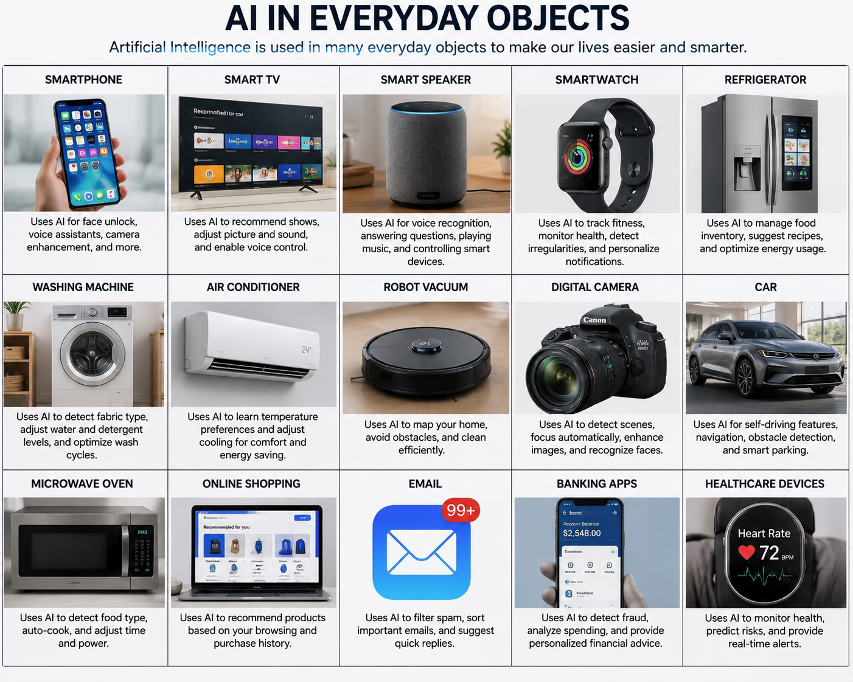

Slide 4
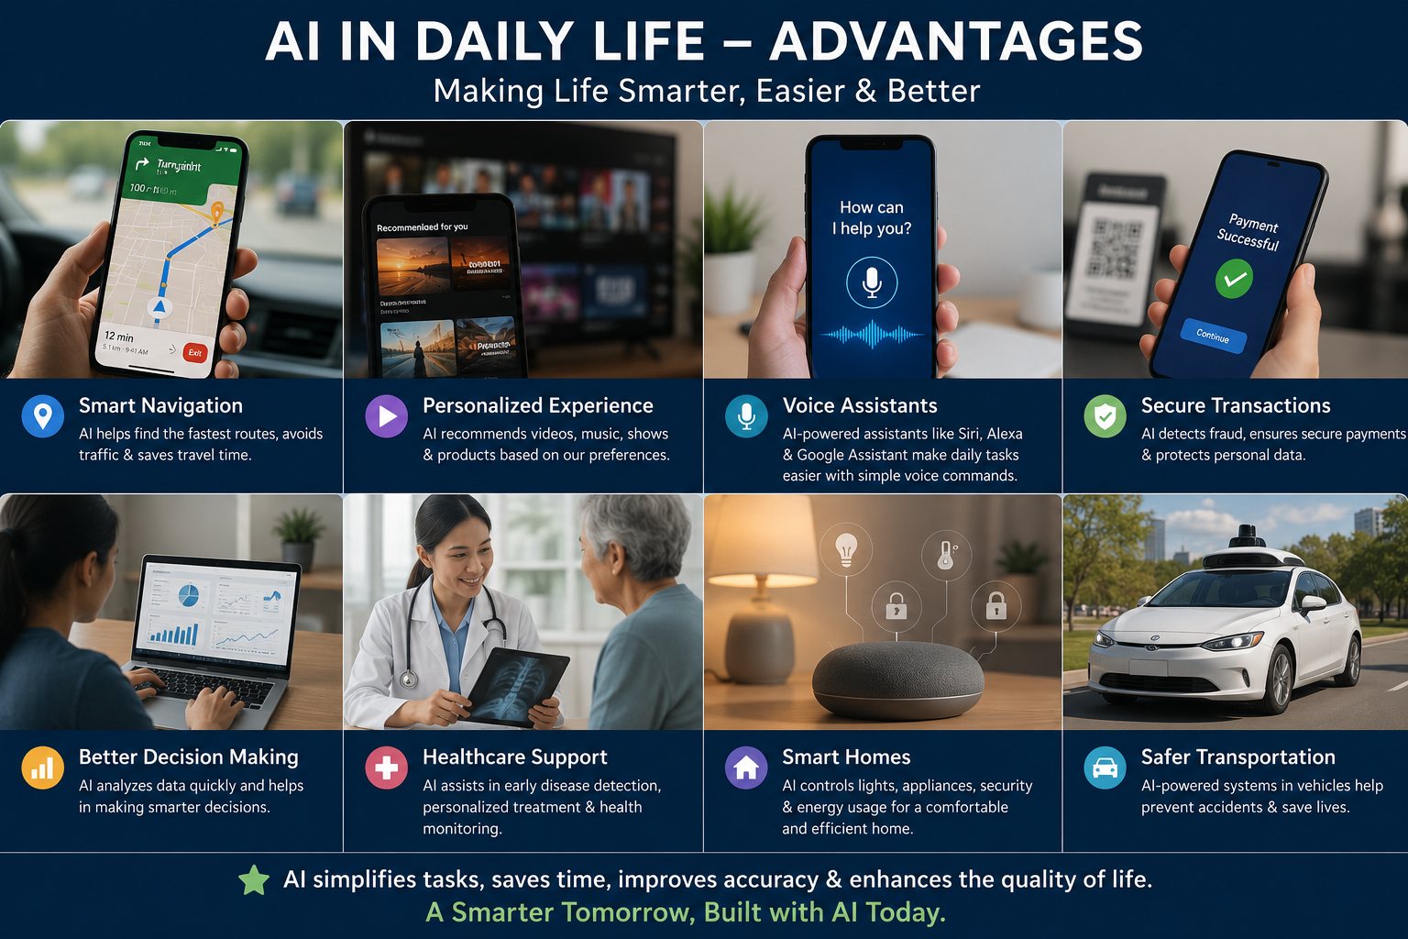
Ai in advantages
Save Time
Reduce Human Errors
work 24/7
Improve Decision – Making
Automates Repetitive Tasks
Better customer service
Supports healthcare
Enhances learning
Makes Everyday life Easier

Slide 5
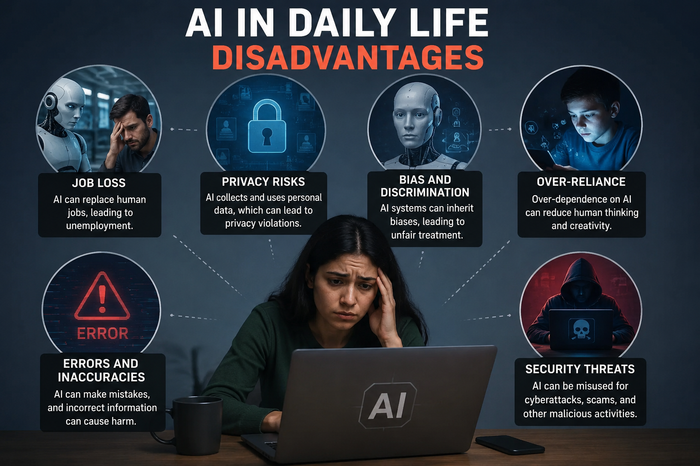
Ai in disadvantages
High cost
Job loss
Lack of Human Emotions
Privacy Concerns
Depends on Technology
Can Make Mistakes
Security Risks
No creativity
Bias and Unfairness
Require skilled Professionals

Slide 6
KEY FEATURES:-
Navigation
Online shopping
Smart home control
Education
Healthcare
24/7 Assistance
Smart Assistance

Slide 7
TYPE OF AI IN DAILY LIFE
Reactive AI
Limited Memory AI
Theory of Mind AI
Self –Aware AI

Slide 8
CONCULSION
Artificial intelligence (AI) is making our lives smarter and more Efficient . It helps people save time, improve productivity , and solve problems in many fields. When used responsibility, AI can create a better and brighter future for everyone

Slide 9
THANK YOU

