Slide 1

AI-BASED CROP DISEASE DETECTION
Presented by
Valarmathi . M
III year
212402314
E-mail : valarmathivalarmathi86395@gmail.com
;

Slide 2
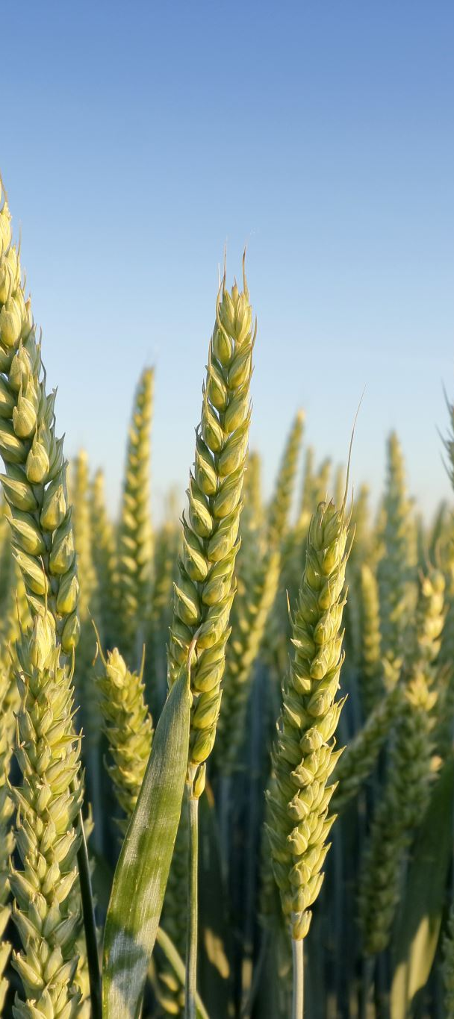
Problem :
Farmers often cannot detect plant diseases at an early stage. If the disease is identified too late:
Crops may be damaged.
Crop yield (harvest) decreases.
Farmers may suffer significant financial losses.

Slide 3
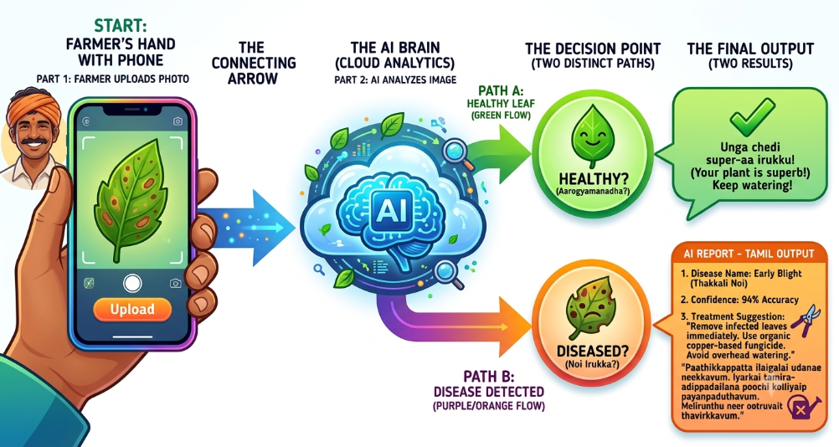

Slide 4
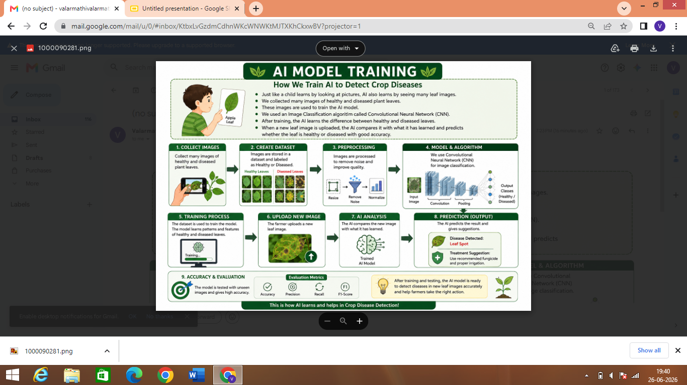

Slide 5
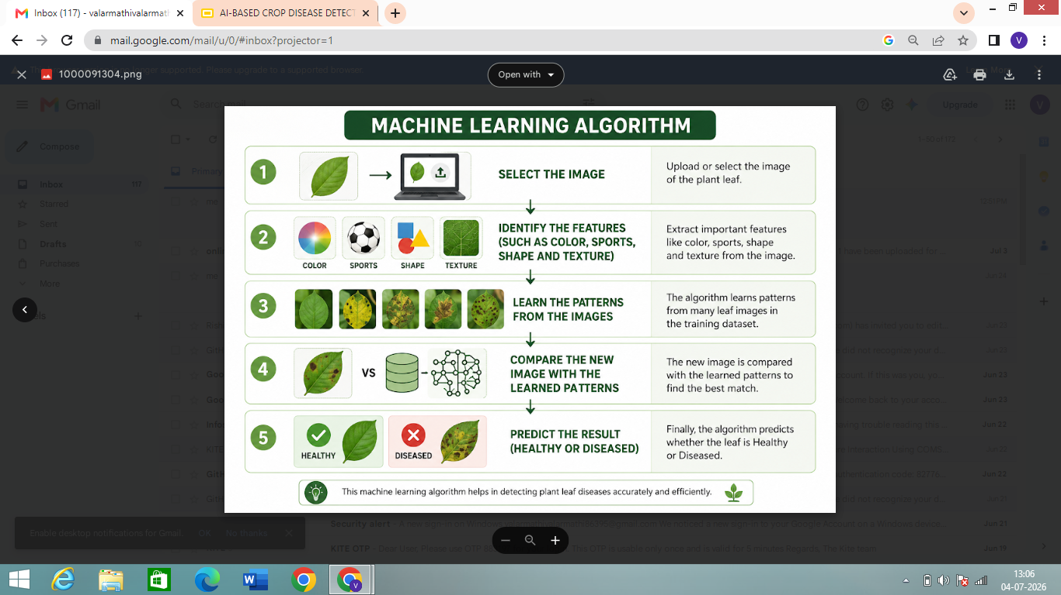

Slide 6
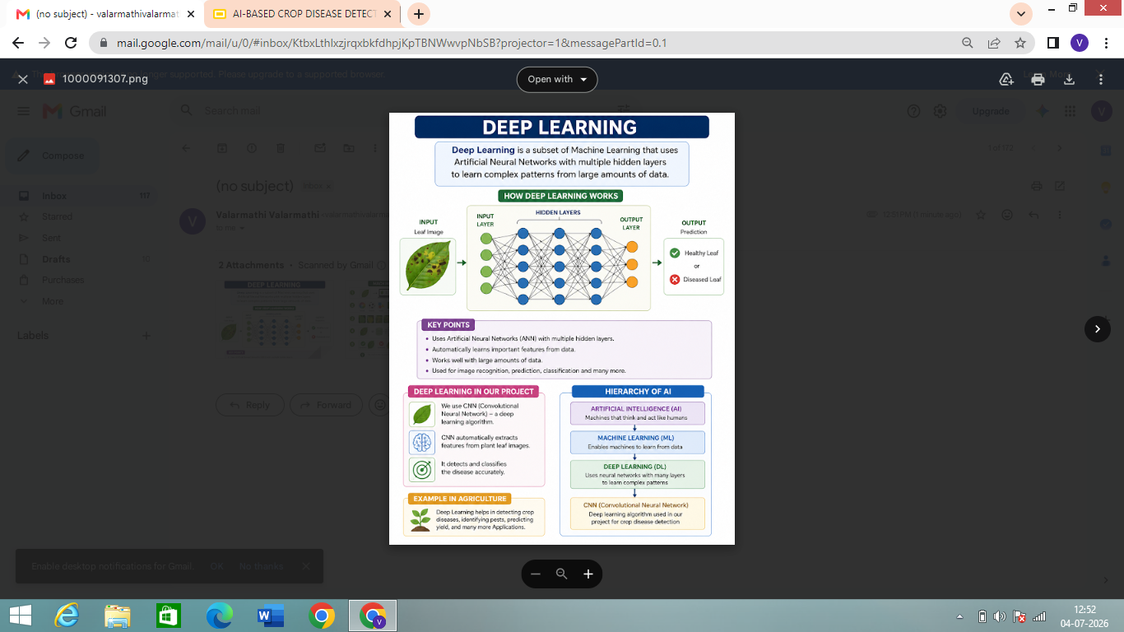

Slide 7
TECHNOLOGY STACK :
React .js (Frontend )
Python ( Backend )
CNN AI Model ( Convolutional Neural Network )
Tensorflow, pytorch
OpenCV

Slide 8
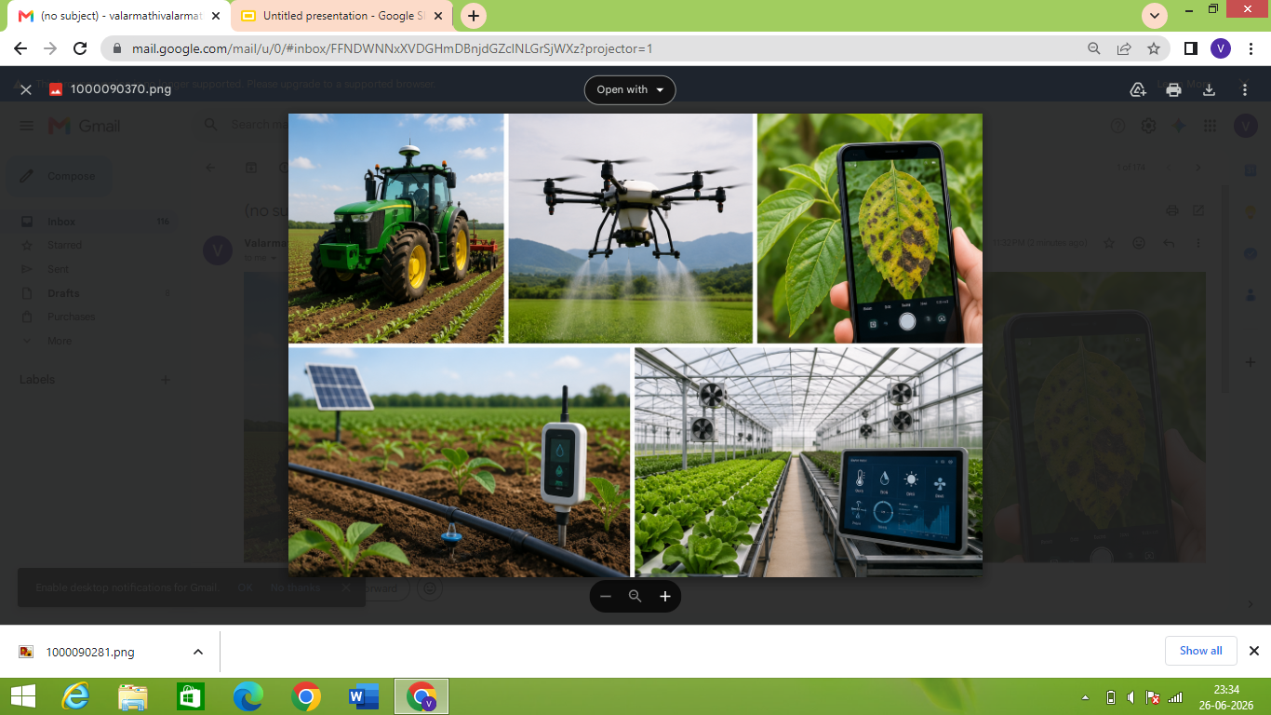
REAL-WORLD AI TECHNOLOGY IN AGRICULTURE

Slide 9
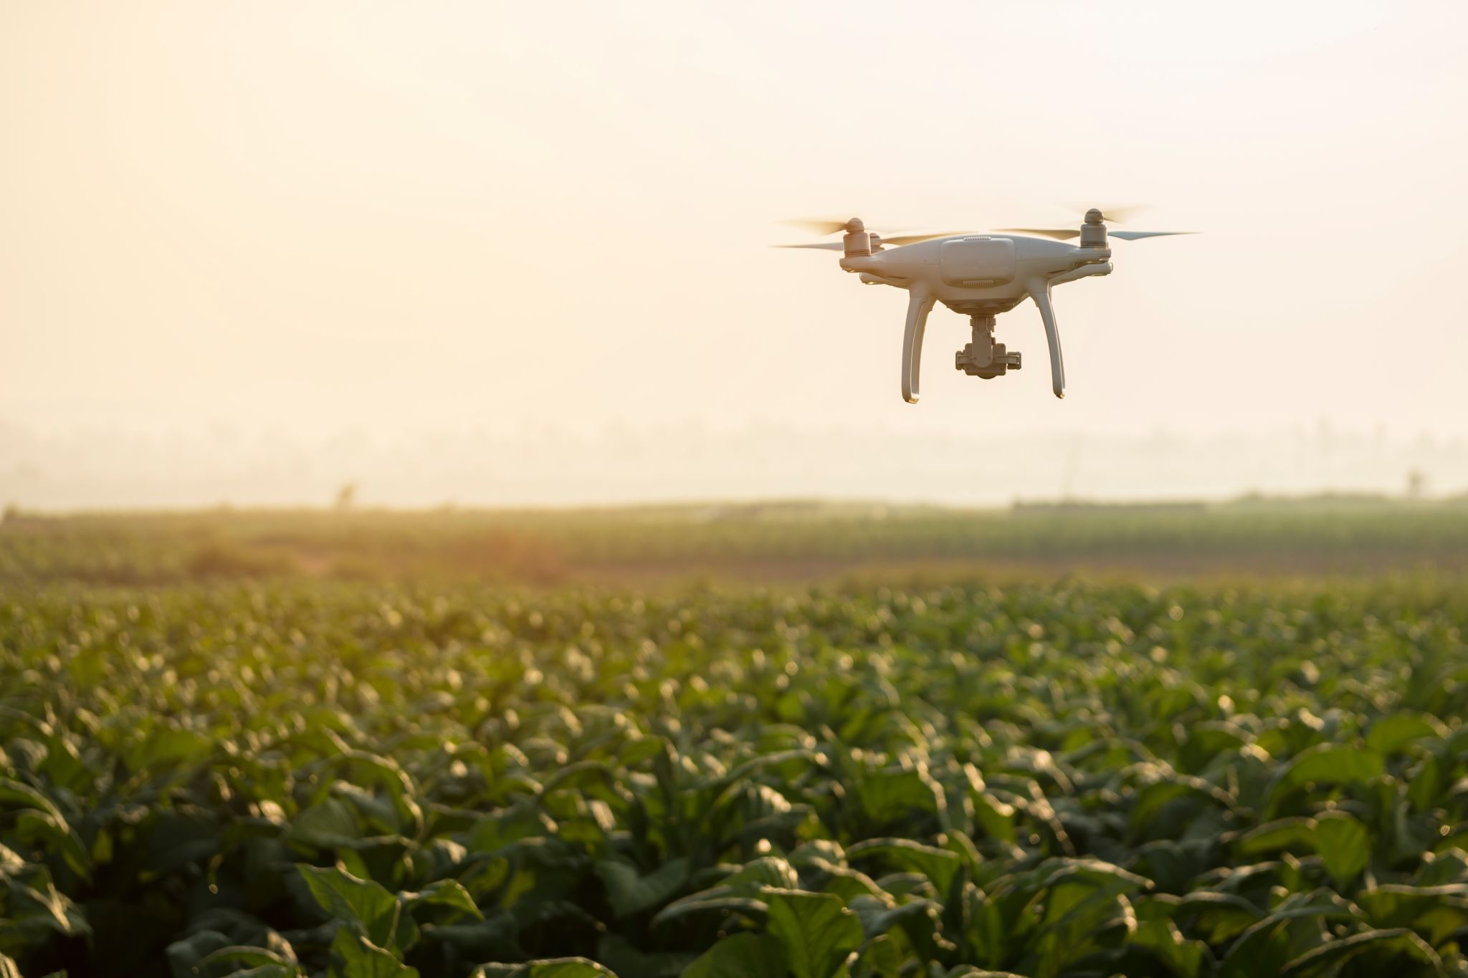
APPLICATION :
Crop disease detection
Smart irrigation
Crop yield prediction
Weather forecasting
Pest detection and control
Autonomous Tractors and Robots
Soil Analysis
Crop monitoring

Slide 10
FUTURE SCOPE :
Smart farming
Autonomous Farm vehicles
Smart irrigation
Crop health monitoring
Weather prediction
Pest and disease detection
Higher crop yield

Slide 11
THANK YOU

